Slide 1
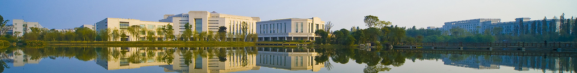
The Photoelectric Effect
University physics center of UEST

Slide 2
outline
content
1 background
2 aim
3 principle
4 equipment
5 procedure and comments
6 exercise
7 data and process

Slide 3
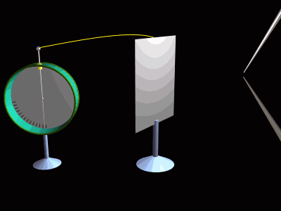
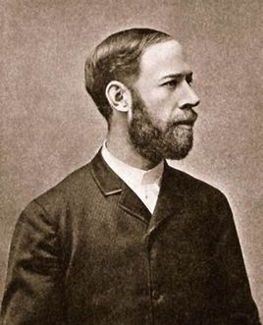
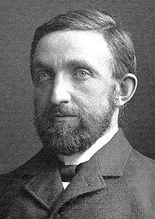
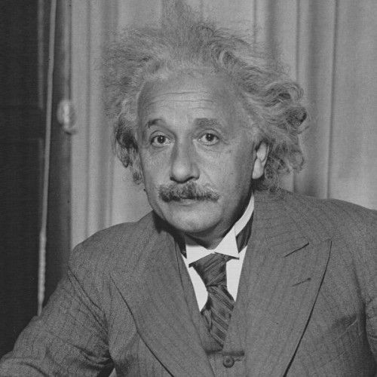
1. background
1.1 Particle Property of Light: Photoelectric Effect
（Heinrich Rudolf Hertz，1857-1894）
1887 found by Hertz
Einstein put forward the correct theoretical mechanism
（Albert Einstein，1879-1955）

Slide 4
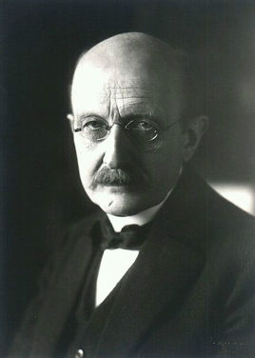

1. background
1.2 Planck 's Constant
Only the assumption that the emission and absorption of electromagnetic waves is carried out in one part, the results of the calculation can be consistent with the test results.
The Concept of Energy Quantum
（Max Planck，1858－1947）
h=6.62559×10⁻³⁴J·s

Slide 5
2. aim
2. aim
By testing the basic characteristics of photoelectric effect curve, to further understand and understand the quantum of light;
Determine the five different frequencies of the reverse cut-off voltage, cut-off voltage and frequency linear relationship, find the "red limit" frequency;
Verify Einstein optoelectronic equation, find Planck constant.

Slide 6
3. principle
3. principle
3.1 phenomena and concepts
Photoelectric effect: light irradiation to the metal surface, there is the phenomenon of electrons from the metal surface to escape.
K
A
Photo-electron：runaway electron。
G
－
V
+
Photo-current：photo electron run from K to A, form the photo current in the circuse。
R
－
E
+
experimental diagram

Slide 7



3. principle
3.2 Experimental law Ⅰ
(1) When v>v₀（ Cut-off frequency ）occurs, related with the cut-off frequency and material, but has nothing to do with the incident light intensity.
K
A
(2) Cut off voltage U₀ linear relation with
Incident light frequency
G
－
V
+
R
－
E
+
Experiment diagram
U₀ ～ν

Slide 8


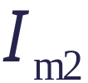






3. principle
3.2 Experimental law Ⅱ
(3) At the same frequency, the saturation photocurrent intensity I_{m} Proportional to the incident light intensity P。
K
A
G
－
V
+
R
－
E
+
The same frequency, different incident light intensity I～U_{AK}
Experiment diagram

Slide 9
3. principle
3.2 Experimental law Ⅲ
(4) Photoelectric effect is a transient effect. When the light is irradiated to the metal surface, almost immediately there is photoelectron escape. Time is less than 10⁻⁹s。
K
A
Can not be used wave kinetic "forced vibration" to explain!
G
－
V
+
R
The solution: quantum mechanics!
－
E
+
Einstein
the successful interpretation of photoelectric effect experiments
Experiment diagram

Slide 10
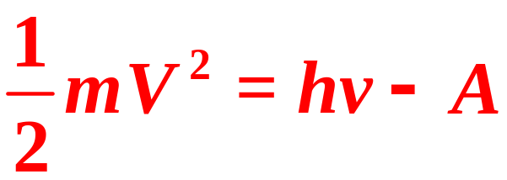
3. principle
3.3 Einstein 's Interpretation of Photoelectric Effect
Photon: A beam of light, consisting of photons, having a frequency of v.
The photon energy is E=hv。
Quantization of energy absorption: When the photon shines on the metal surface, an electron in a metal absorption and can only absorb the energy of a photon, without the accumulation of energy of time.
Energy Conservation: Electrons use part of the photon energy to overcome the metal surface for electron binding and work A, the rest of the electrons leave the metal surface after the kinetic energy.
Photoelectric effect equation ：
Escape energy

Slide 11
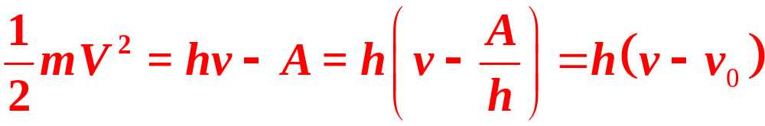
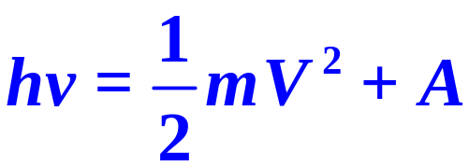

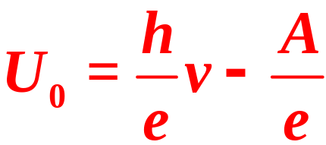
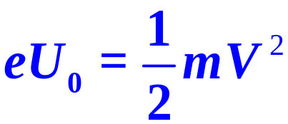
3. principle
3.3 Einstein 's Interpretation of Photoelectric Effect
Discussion ：
（1）when hv<A ，v<v₀，electron can’t escape from metal, no current
Red limit frequency
（2）
(by measurement)
Cut off voltage U₀ incident light frequency v linear relationship
The slope of the straight line to calculate the Planck constant h.

Slide 12
3. principle
3.3 Einstein 's Interpretation of Photoelectric Effect
disscution：
（3）When the frequency is constant, the greater the incident light intensity P, the more the number of photons, the unit of time to produce the number of photoelectrons, the greater the intensity of saturated photocurrent.
At the same frequency, the saturation current intensity I_{m} is
proportional to the incident light intensity P.
（4） When the photon incident metal surface, a photon carrying energy hv once for an electron all absorbed, if v>v₀, electrons immediately escape without time accumulation.
Photoelectric effect with instantaneous.

Slide 13
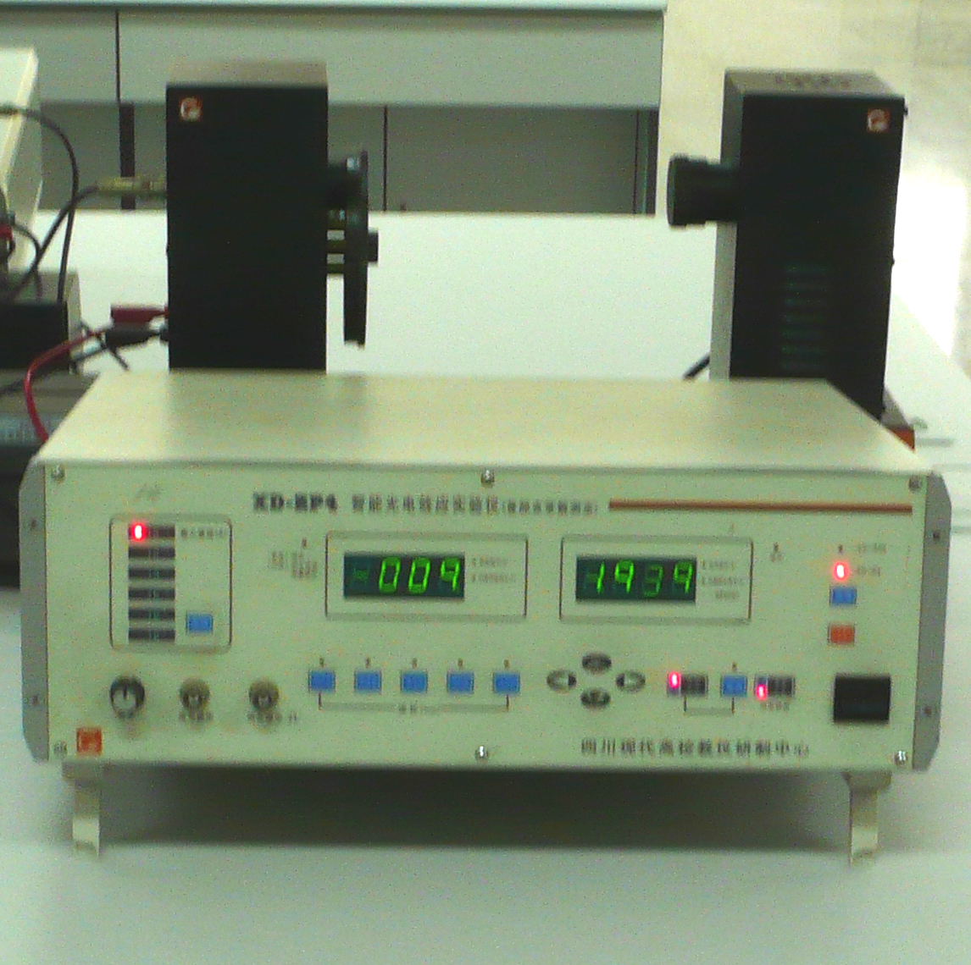
4. Equipment
4. Equipment
Mercury lamp
Filters (5 wavelengths available)
GDH-1 type photoelectric tube
Micro - current amplification measuring instrument

Slide 14
5. Procedure
5. Operating procedures and methods
Once the mercury lamp is turned on, do not turn it off.
No require a darkroom environment, but avoid changes in background light.
During the experiment, please pay attention to cover the cover of the mercury lamp at any time. Do not let the mercury light enter the photoelectric tube window directly without passing through the filter.
The end of the experiment photoelectric tube and mercury lamp shade covered!
The instrument should not be in a strong magnetic field, strong electric field,
strong vibration, high temperature, with radiation material environment.
Store the instrument in a ventilated and dry place, plus dust cover.

Slide 15
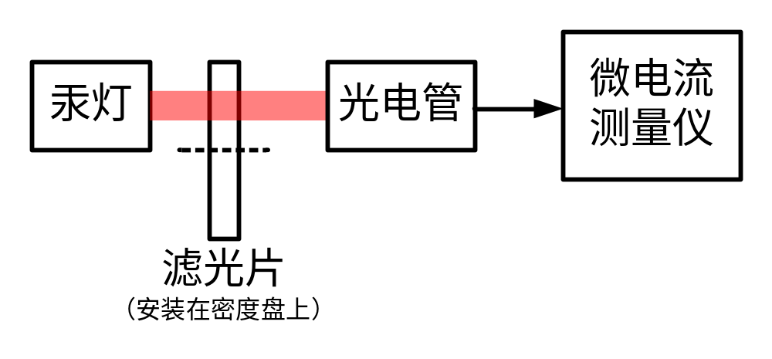
5. Procedure
5.2 experiment layout
Prepare work
（1）Place the instrument and cover the light window and the light source window of the photoelectric cartridge respectively with the light window cover. Turn on the power switch and warm up for 10-30 minutes.
(2) the micro-current tester and the photocell tube between the wires connected to adjust the light source light window and the photoelectric tube box light window height, photoelectric tube box placed in the middle 40cm is appropriate.

Slide 16
5. Procedure
5.3 Experimental regulation essentials
Measure the photocurrent characteristic curve of the I-V
（1） Basic parameter setting
Filter: 577nm; Voltage range: -2V ~ 50V; Current range: 10⁻¹¹A
（2）Light intensity setting
Light: mercury lamp to the photoelectric tube box distance of 30cm
Low light: mercury lamp to the photoelectric tube cartridge distance 40cm

Slide 17
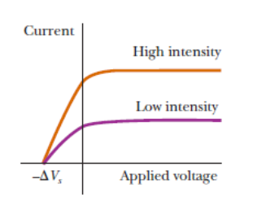
5. 操作步骤和要领
5.3 Experimental regulation essentials
Measure the cut off voltage
（1） Basic parameter setting
Filter: 365nm, 405nm, 436nm, 546nm and 577nm choose one;
Voltage range: -2V ~ 0V; current range ：10⁻¹³A
（2）judgment of cut off voltage
Measured voltammetry characteristics of photovoltaic cells as shown.

Slide 18
6. Exercise
6. Exercise
In this experiment, such as changing the illumination on the photoelectric tube, the I-V curve have any effect?
Photocathode cathodes are coated with a small work out of the photosensitive material, and the anode is elected off the power of metal manufacturing, and why?
Is it possible for photo-electricity to occur only on metal surfaces? why?

Slide 19
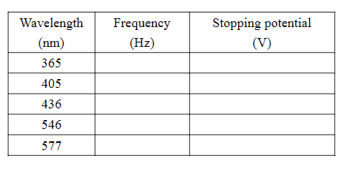
8. Data and process
8. Data and process
8.1 cut off voltage
table1 cut-off voltage with different frequency

Slide 20
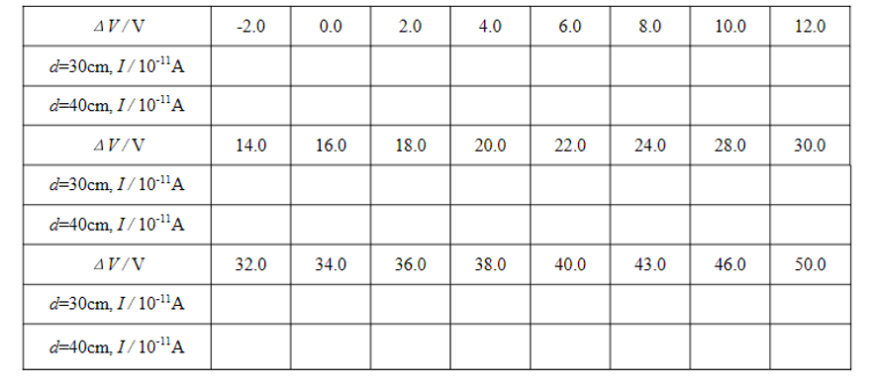
8. Data and process
8.2 I-V curve of photo-electric tube
Table 3 I-V curve
for：
（1）least-square fitting find out the values of the Plancks constant and the work function of the metal in photoelectric tube.
（2）Use the data in Data Table 7-2 to draw a graph of the current depending on the voltage for the photoelectric tube illuminated by different intensities.

